Slide 1
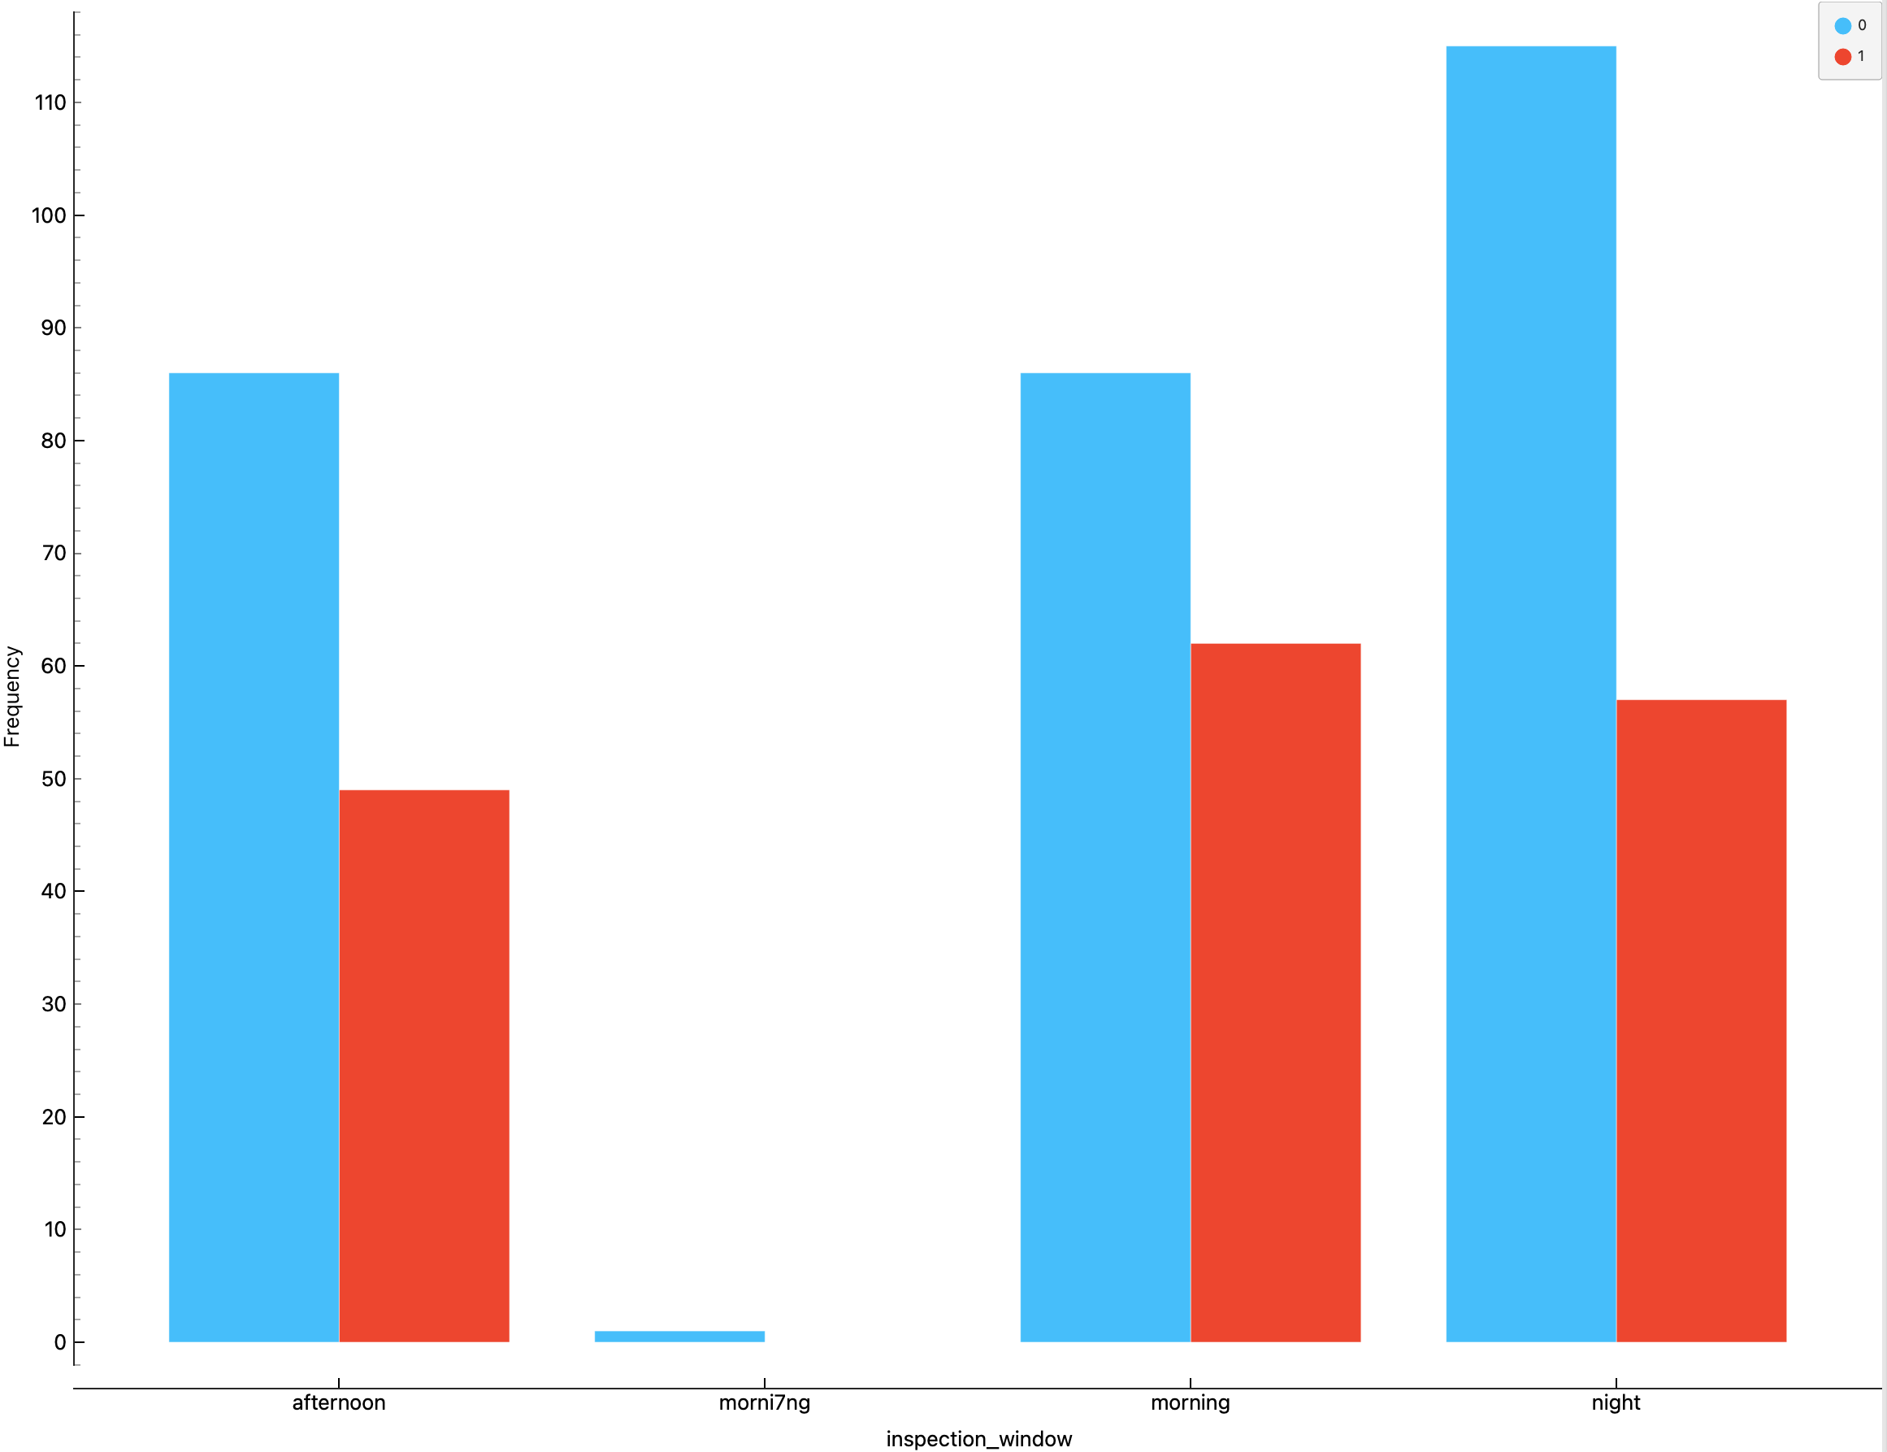
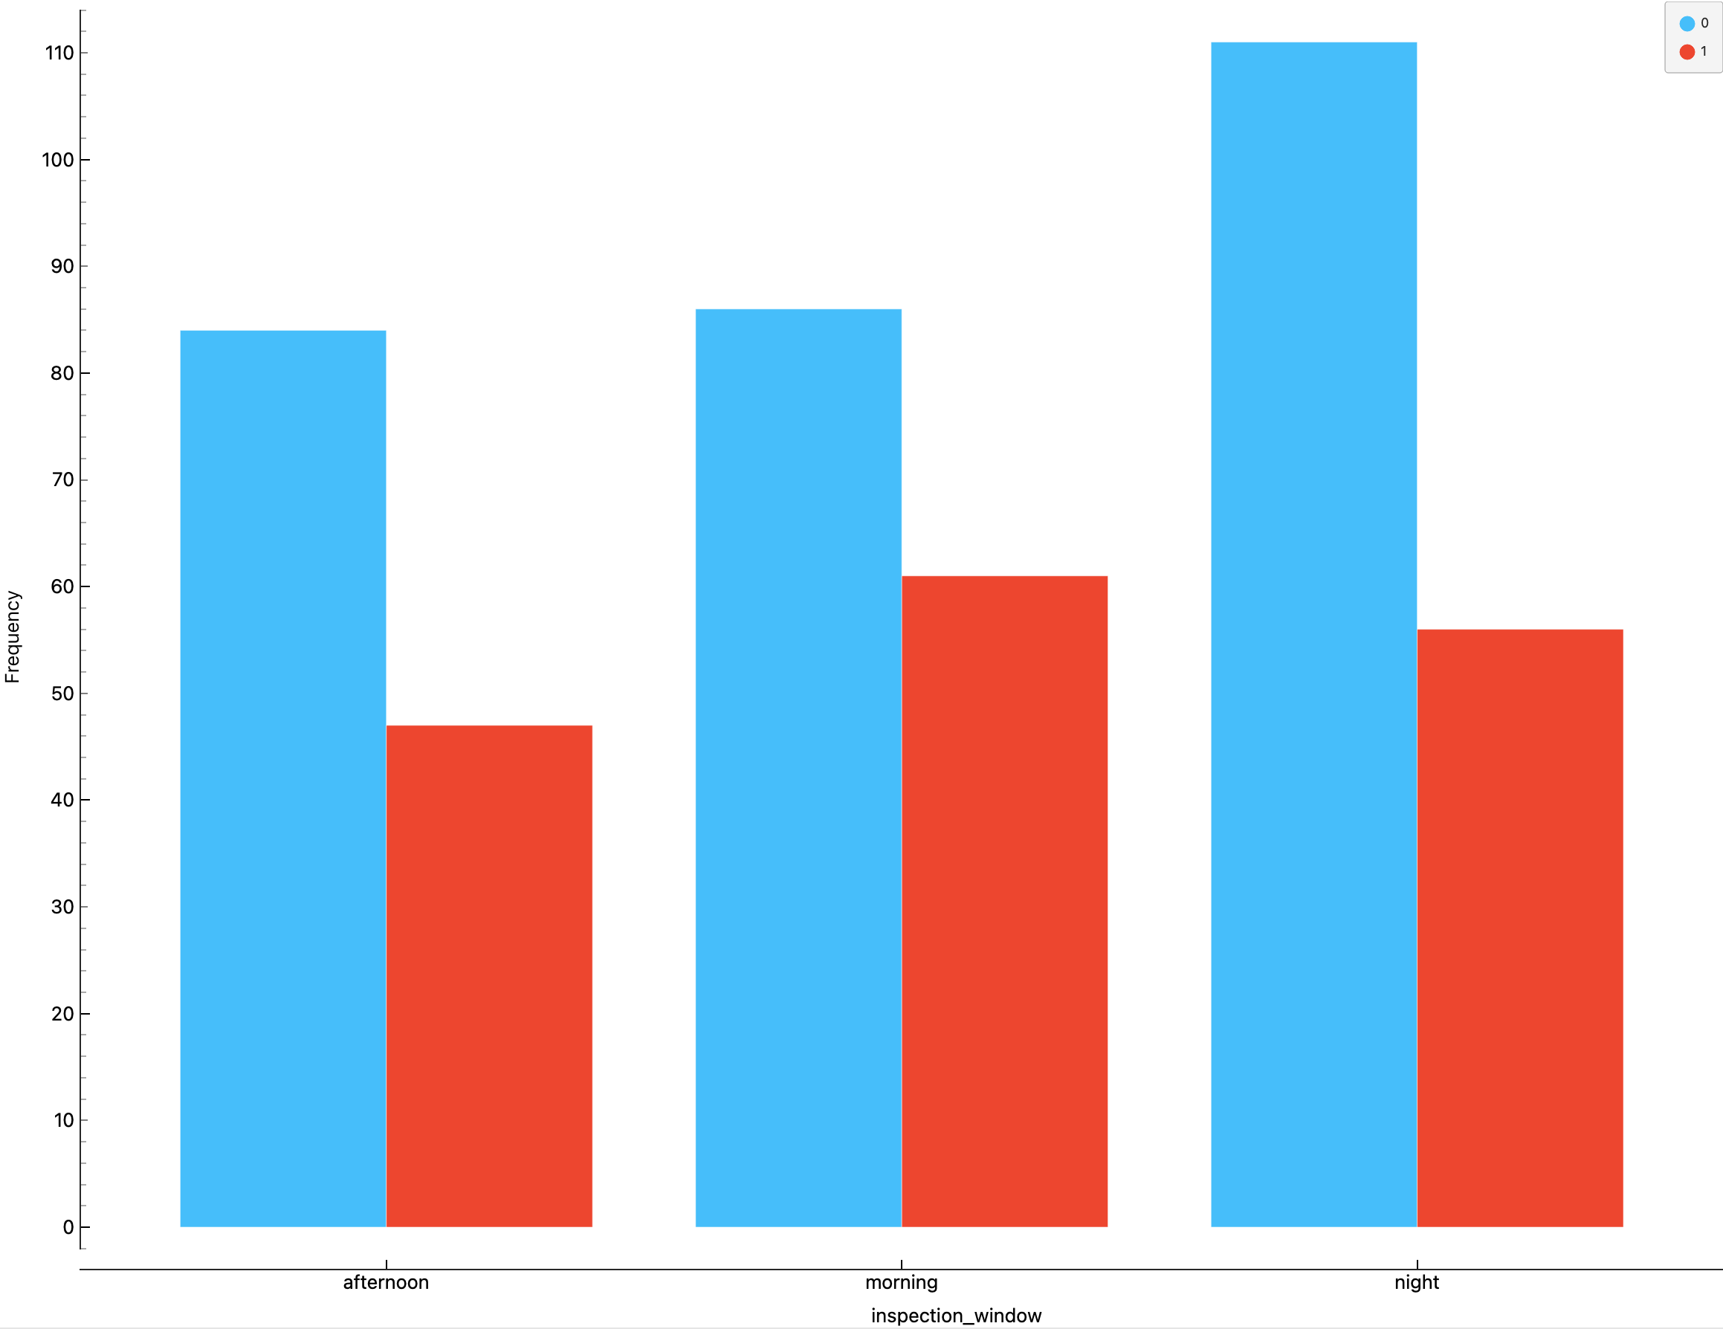
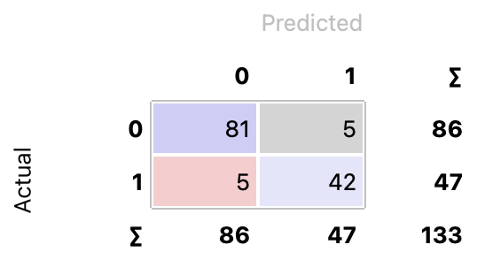
ITNPBD6 Assignment 1. Student Number 3461226
2. Project Methodology
1. Task Understanding This is a binary classification task with the target variable failure, where a predicted probability of failure ≥ 0.5 indicates infrastructure failure.
The goal is to predict the probability of infrastructure failure in a city block during the monitoring period.
A ’good model’ for this task should: • accurately predict infrastructure failure; • minimise false negatives to avoid missing high-risk areas (high Recall for the failure class is the most important metric for this task); • generalise well to unseen data to be useful in real-world applications.
In addition, it is important to identify which features have the greatest impact on failure, as this can provide valuable insights for decision-making and risk minimisation.
2. Data Understanding Inputs to the model: Input variables are describing infrastructure and environmental conditions (except of inspector_id, which identifies an inspector and not contain information about infrastructure). Output of the model is the binary categorical variable failure (target), which takes the value 0 – for no infrastructure failure and 1 - for failure occurs. To solve this task, we cannot use conventional software because we do not know the exactly rules under which a failure occurs. Besides, many factors may influence the failure simultaneously and there may be complex dependencies between them. Machine Learning is the best way to solve this problem because it automatically finds pattern in the data, uses past observations, and model the probability of failure. Data visualisation was used to explore feature distributions and identify potential issues. Histograms showed that some features have significant impact on failure, where higher values increase probability of failure, and that failures occur mostly in summer period. Examination of the data distribution also revealed that there are some errors in the dataset.
3. Data Preparation • Visualisation showed that the inspector_id has a flat distribution and therefore, is not useful for prediction and was removed from the dataset. • Some errors were identified and corrected before splitting the data (e.g. sumer and morni1ng). • Additionally, there were 0.2% missing values (only 11 instances in the dataset), and these rows were deleted as such a small amount of data is unlikely to affect model performance and it is better option than attempting to estimate imputed missing values. • The dataset was then split into 70% training data and 30% test data. • An outlier was identified and deleted in material_flexibility feature. • The categorical variables were encoded using one-hot encoding. • As the variables are on different scales, so normalisation was applied before model development.
4. Model Training and Hyperparameter Tuning Three models (Logistic Regression, Decision Tree, Neural Network) were trained and tuned by varying hyperparameters systematically. Logistic Regression achieved Recall = 0.919, AUC = 0.971; Neural Network: Recall = 0.928, AUC = 0.965; and Decision Tree: Recall = 0.889, AUC = 0.938.
5. Feature Projection Principal Component Analysis was applied to the dataset; however, it decreased the accuracy of the models. PCA reduced the number of dimension, but it also worsened the separability by mixing the classes and losing important relationships between the features, which led to poorer model performance.
Manifold learning was also applied, but it resulted in a slight decrease in model accuracy as well. Therefore, these methods were excluded from the final modelling pipeline.
6. Feature Selection Filter-based (correlation/ranking) method was applied to identify the most relevant features. The results showed that several features had very low predictive value. After removing these weak features, model performance improved, with the following results:
1) Logistic Regression: Recall = 0.935, AUC = 0.972; 2) Neural Network: Recall = 0.919, AUC = 0.971; 3) Decision Tree: Recall = 0.902, AUC = 0.918.
A wrapper-based approach was also applied, which confirmed the same best subset of 9 features, with the following results:
1) Logistic Regression: Recall = 0.935, AUC = 0.971; 2) Neural Network: Recall = 0.932, AUC = 0.968; 3) Decision Tree: Recall = 0.899, AUC = 0.940.
Overall, Feature Selection reduced dimensionality, training time, model complexity, removed noise and improved model performance.
Considering all 5-fold cross-validation evaluation metrics, Logistic Regression was selected as the final model, as it achieved the best overall performance.
7. Test Data Preparation The test data was transformed using the same encoding and normalisation parameters derived from the training data.
8. Final Model Evaluation The Logistic Regression model was evaluated on unseen test data, achieving Recall = 0.925 and AUC = 0.958.
It is important to note that the Recall of the model can be further increased by adjusting the classification threshold. The current threshold is set to 0.5; however, the ROC curve suggests that a more suitable threshold for this problem is approximately 0.34. Lowering the threshold would make the model more sensitive to failure, reducing false negatives at the cost of increasing false positives. This trade-off may be acceptable in this task, where missing a failure is more critical than generating false alarms.
3. Variables
Almost all input variables are continuous numeric features; only two variables (inspection_season, inspection_window) are categorical and were encoded using one-hot encoding for Logistic Regression and Neural Network models. Additionally, there is one discrete numerical variable – inspector_id, - which identifies an inspector and has almost nothing to do with failure. This variable adds unnecessary dimension to the model, increase its complexity, and introduces more noise. Thus, it was removed from the dataset. During the Feature Selection stage, inspection_window, inspection_season=autumn/spring, and vibration_exposure were deleted due to their very low predictive value.
This improved model performance by reducing dimensionality, model complexity and noise.
4. Data Preparation
The inspection_window variable before and after cleaning.
5. Model Training and Hyperparameters
A number of models were built using different hyperparameter settings. A systematic approach was applied, where only one hyperparameter was varied at a time. Each model was evaluated using 5-fold cross-validation. The optimal hyper parameter configuration was selected based on maximising Recall, with AUC used as a secondary performance metric.
6. Final Model & Results
After applying Feature Selection method, Logistic Regression achieved the best performance, with the highest recall
(Recall = 0.935, AUC = 0.972) and was therefore selected as the final model.
Confusion Matrix shows the following:
• True Negatives (TN) = 81
(correctly predicted no failure);
• False Positives (FP) = 5
(predicted a failure when none occurred);
• False Negatives (FN) = 5 (missed a failure);
• True Positives (TP) = 42
(correctly detected failure cases).
Recall = TP / (TP + FN) = 42 / (42 + 5) ≈ 0.894
This means that the model correctly identifies about 89.4% of all failure cases.
The Recall obtained from the confusion matrix differs slightly from the cross-validation result, as it is calculated on a single test split rather than averaged across 5 folds. Overall, the relatively low number of false negatives indicates that the model is effective at identifying high-risk cases.
Model | Hyperparameters | Valid. Metric
1. Logistic Regression | • L1-regularisation (Lasso), C : 0.001, 0.01, 0.05, 0.1, 0.2, 1, 10, 100, 1000; • L2-regularisation (Ridge), C : 0.001, 0.01, 0.05, 0.1, 0.2, 1, 10, 100, 1000 The best result was achieved at L2, C = 0.05 and class balancing. | Recall = 91.9% AUC = 97.1%
2. Neural Network | • Neurons in hidden layers: 10, 20, 50, 100, 200, 300; • Activation functions: ReLu, tanh, logistic; • Solver: Adam, L-BFGS, SGD; • Regularisation: 0.0001, 0.001, 0.01, 0.1, 1, 2, 3, 4, 5, 6, 7, 8, 10, 15; • Max iterations: 50, 100, 200, 300, 400, 500, 700, 800, 1000. The best result: 50 neurons in hidden layer, tanh function, SGD solver, 200 epochs. | Recall = 92.8% AUC = 96.5%
3. Decision Tree | • Minimum number of instances in leaves: 2, 5, 10, 20; • Split subsets: 5, 10, 20, which did not have any effect on the results; • Maximum tree depth: 2, 5, 8, 10. The best result: 10 instances in leaves, 5 split subsets and a max tree depth of 10. | Recall = 88.9% AUC = 93.8%
7. Insight About Data
Features such as surface_debris, structural_mass_ratio, recent_precipitation, infrastructure_age, moisture_stress have a significant impact on infrastructure failure, with higher values associated with an increased probability of failure.
In contrast, features such as inspection_window, inspection_season = autumn/spring, and vibration_exposure showed almost no predictive value and were removed during feature selection. The analysis also indicated a clear environmental influence, with failures occurring more frequently during the summer period. This suggests that weather conditions play an important role. Overall, infrastructure failure depends on both structural characteristics and external environmental factors (weather/level of usage). No strong model bias was observed; but some seasonal variation is present in the data.
Logistic Regression was selected as the final model due to its strong performance and interpretability. Its coefficients indicate the direction and strength of the relationship between each feature and the probability of failure, helping to understand which factors lead to failure. Besides, it is fast (learns and predicts quickly), simple to tune (few hyperparameters), and practical for real-world decision-making. This demonstrates that simpler, interpretable models can achieve both high performance and practical value in real-world applications.
8. References
1. Lecture materials, University of Stirling

